Slide 1
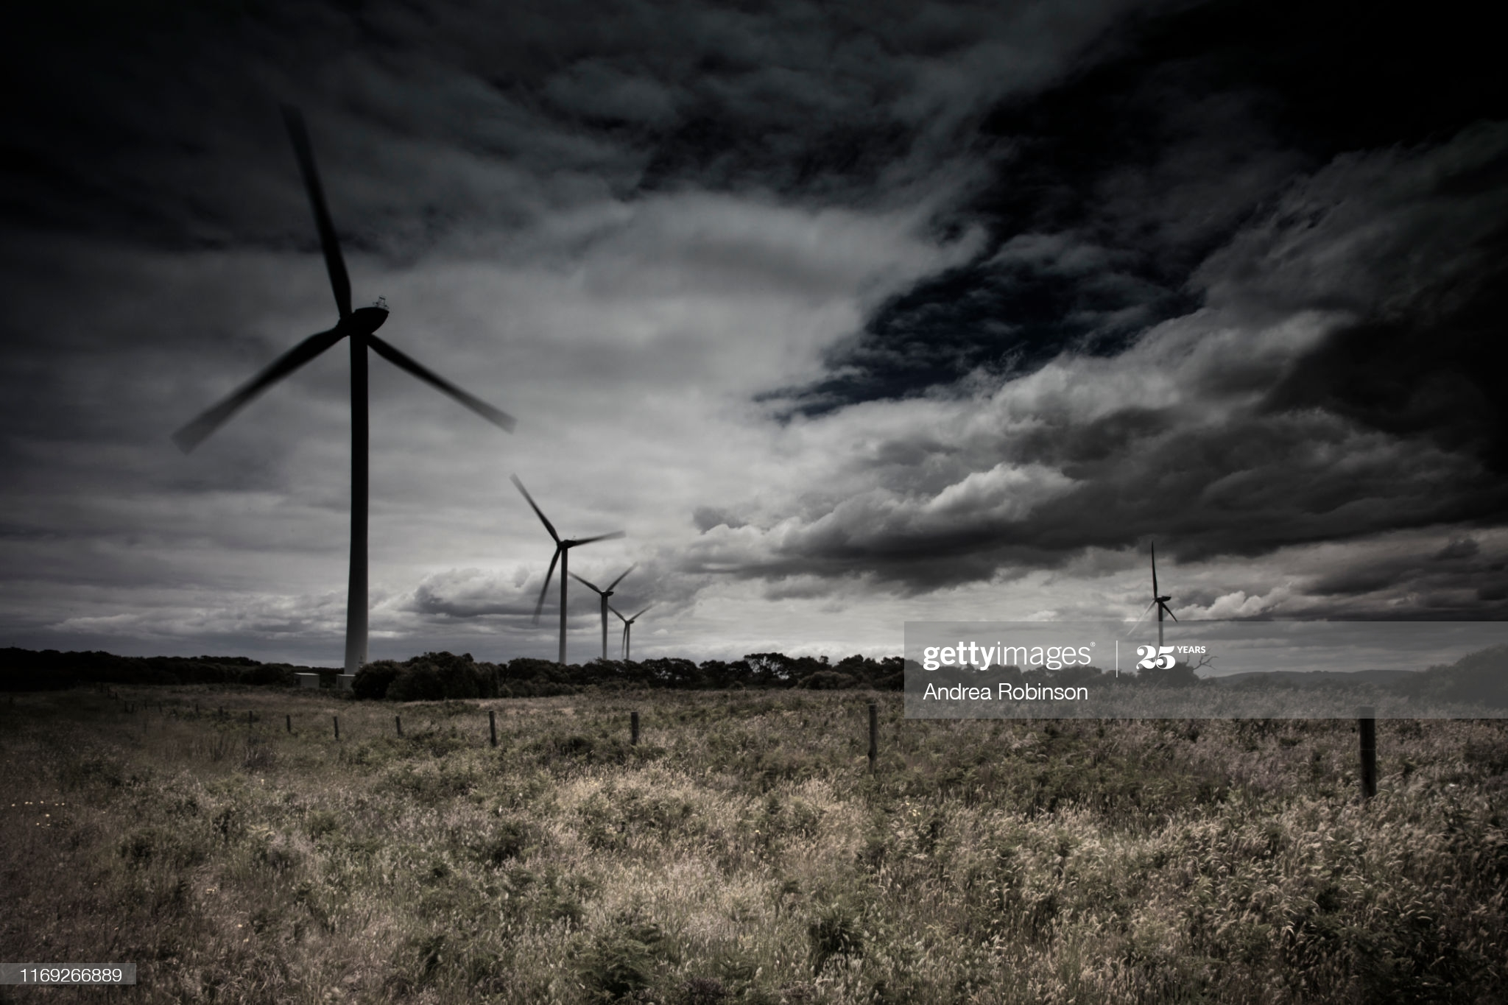
“ There’s Weather. Then There is business Weather.”
Wind’s Dance With Ensemble
A Driverless Wind Forecaster
Adhyansh Bhardwaj
Anant Jakhmola

Slide 2
APPROACH
1. Questions like What to forecast, Who will use the forecast, What can be the impacts of the forecast.
2. How much to Forecast (Forecast Horizon) ?
3. Model Selection (A single stick is easy to break but the group is always strong i.e. Ensemble).
End Goal?

Slide 3
SOLUTION
1. WE SELECTED 5 LARGEST WIND FARMS OF INDIA AND TRAINED AN COMBINATION OF MACHINE LAERNING, STATISTICAL LEARNING AND DEEP LEARNING MODELS ON THEM.
2. OPTIMUM OUTPUT, THE END GOAL WAS TO DETERMINE THE BEST FOR EXTRACTING ENERGY FROM EACH FARM.
3. PROVIDED ON DEMAND FORECAST FACILITY FOR ANY FARM IN THE WORLD.
4. EMPHASIS ON A STABLE APPLICATION.

Slide 4
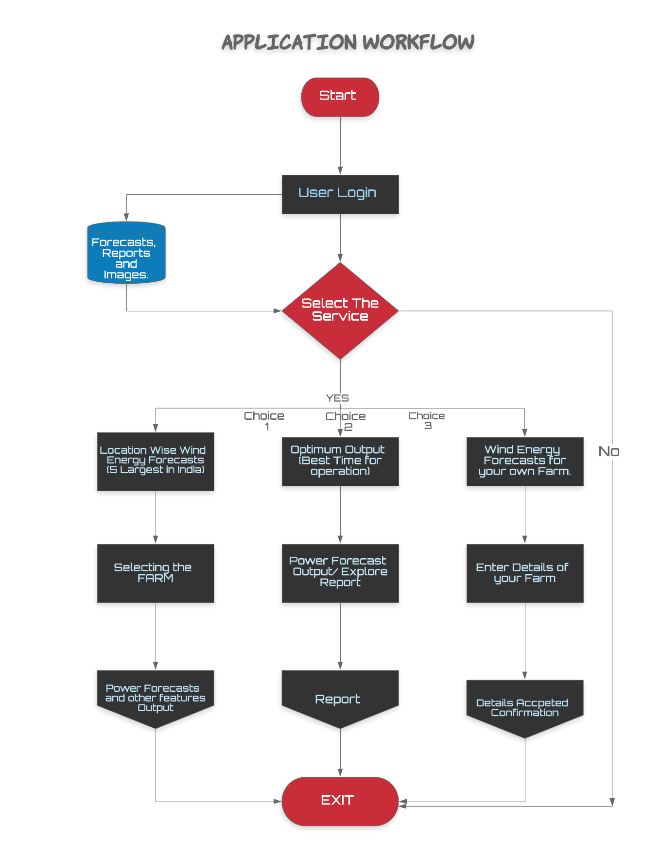

Slide 5
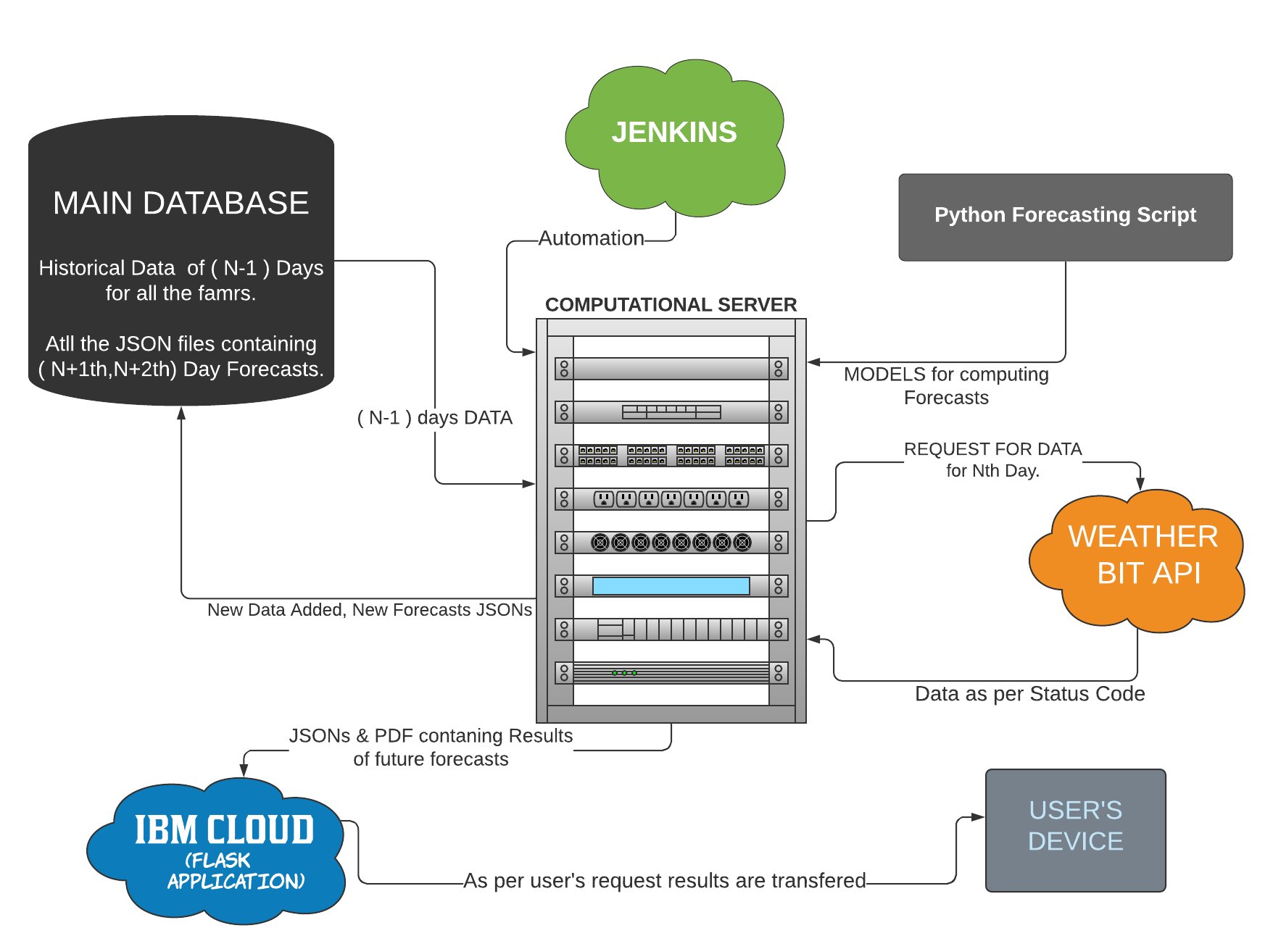
BACK END FLOW

Slide 6
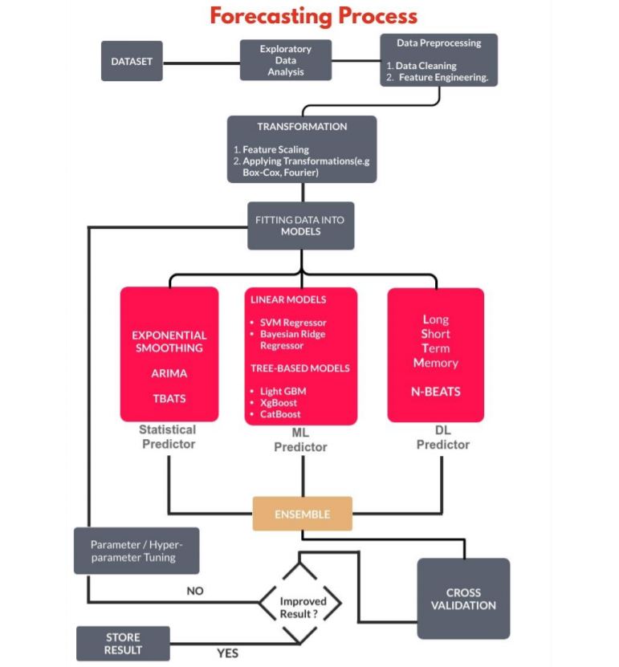

Slide 7
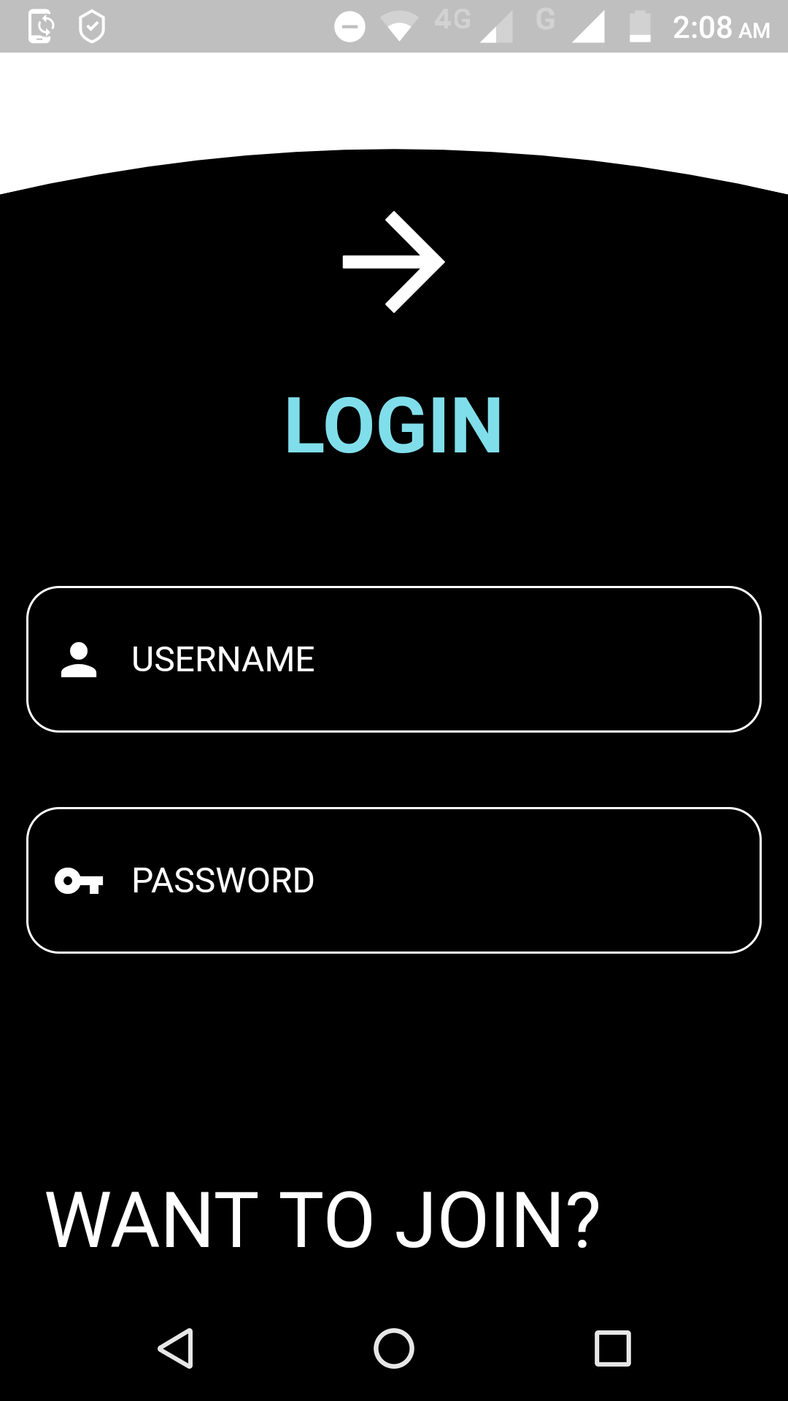
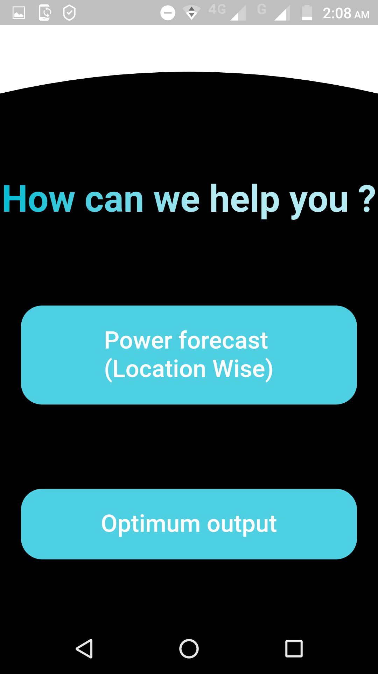
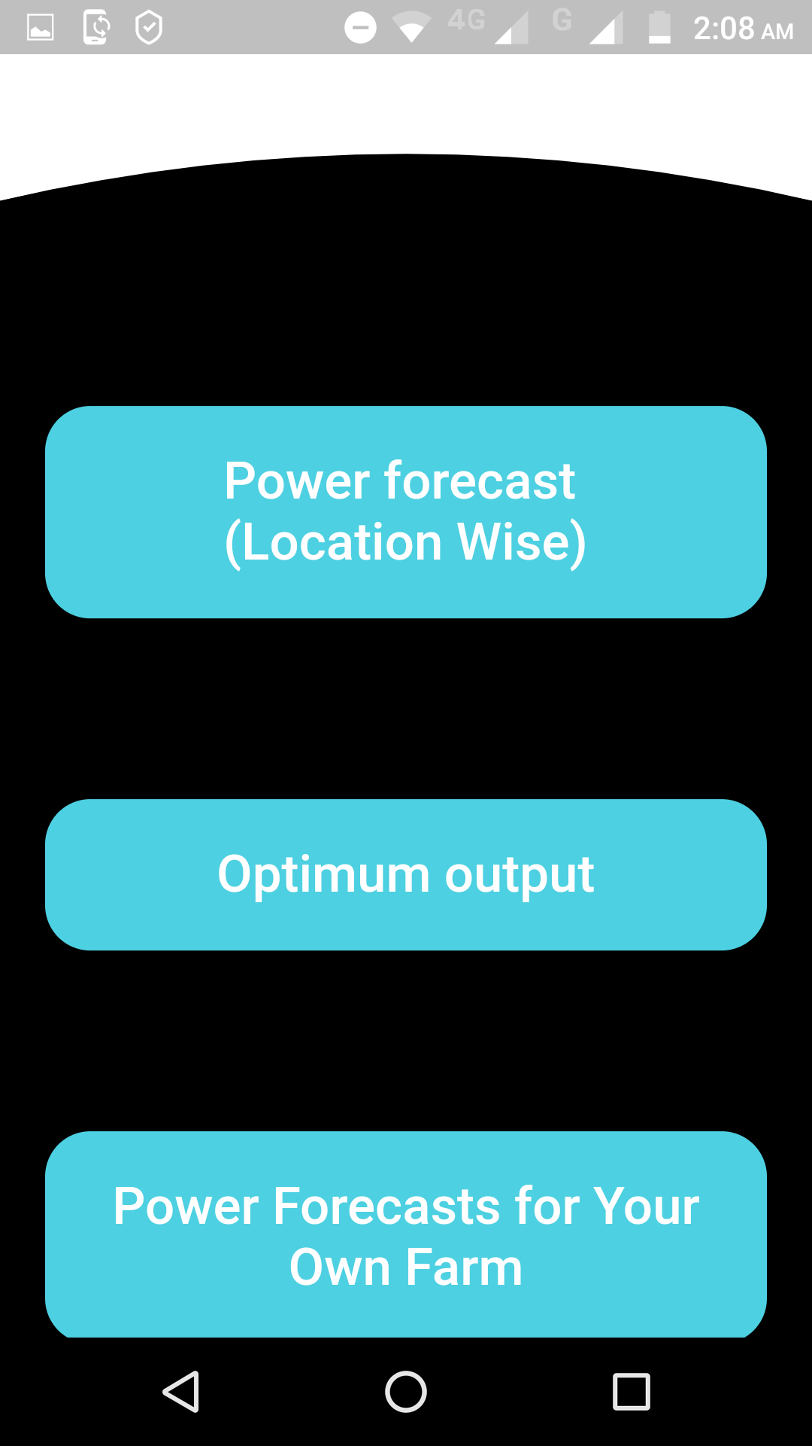
USER INTERFACE

Slide 8
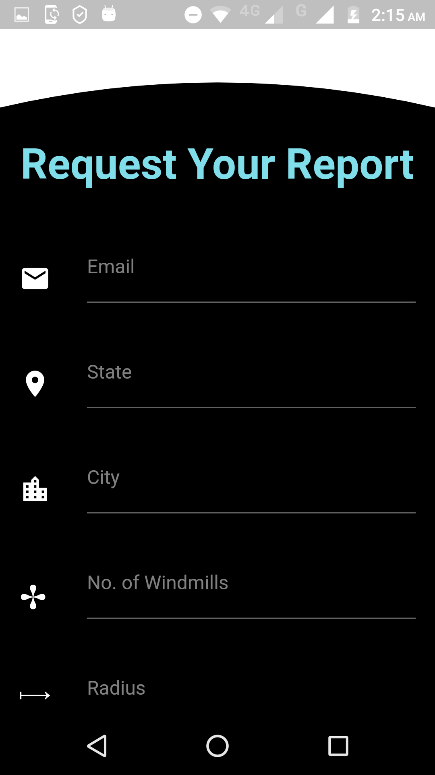
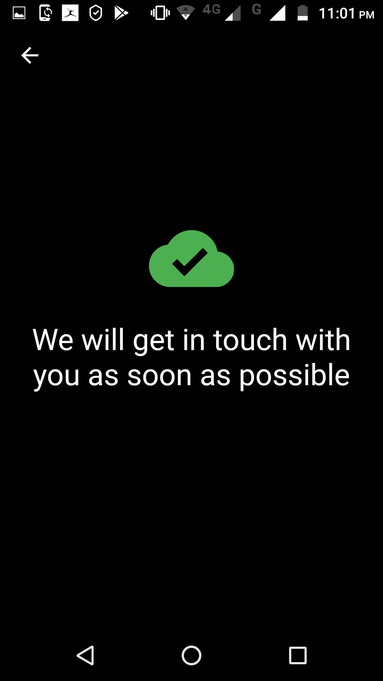
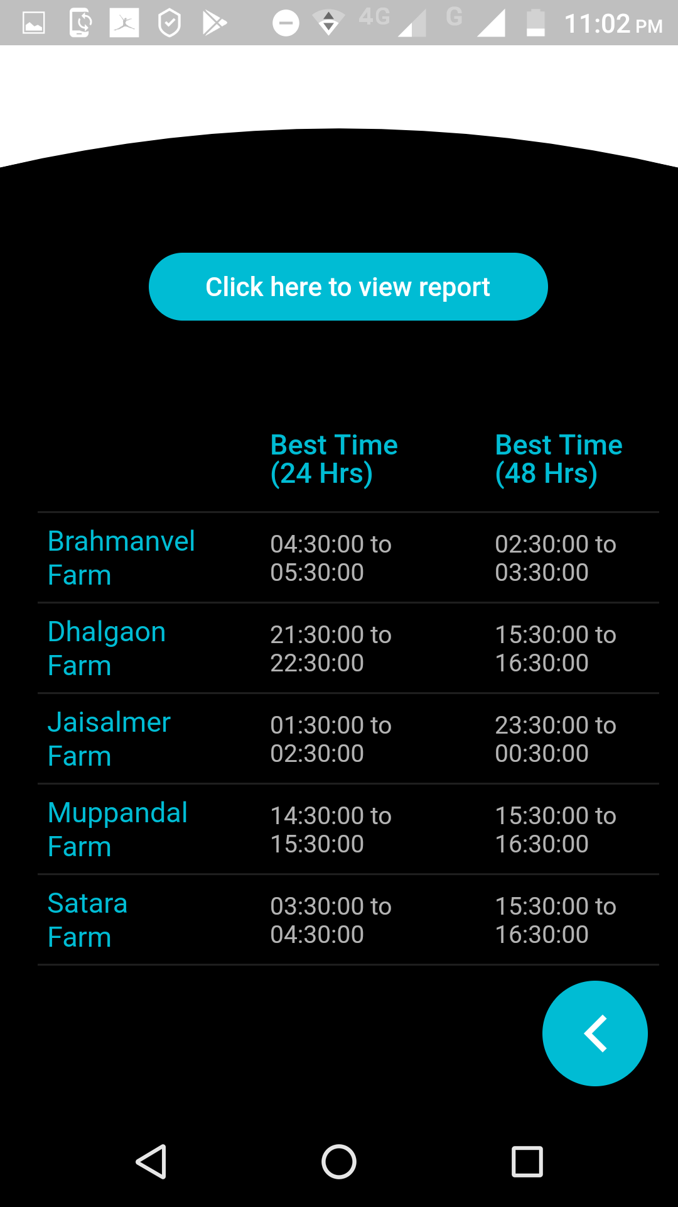
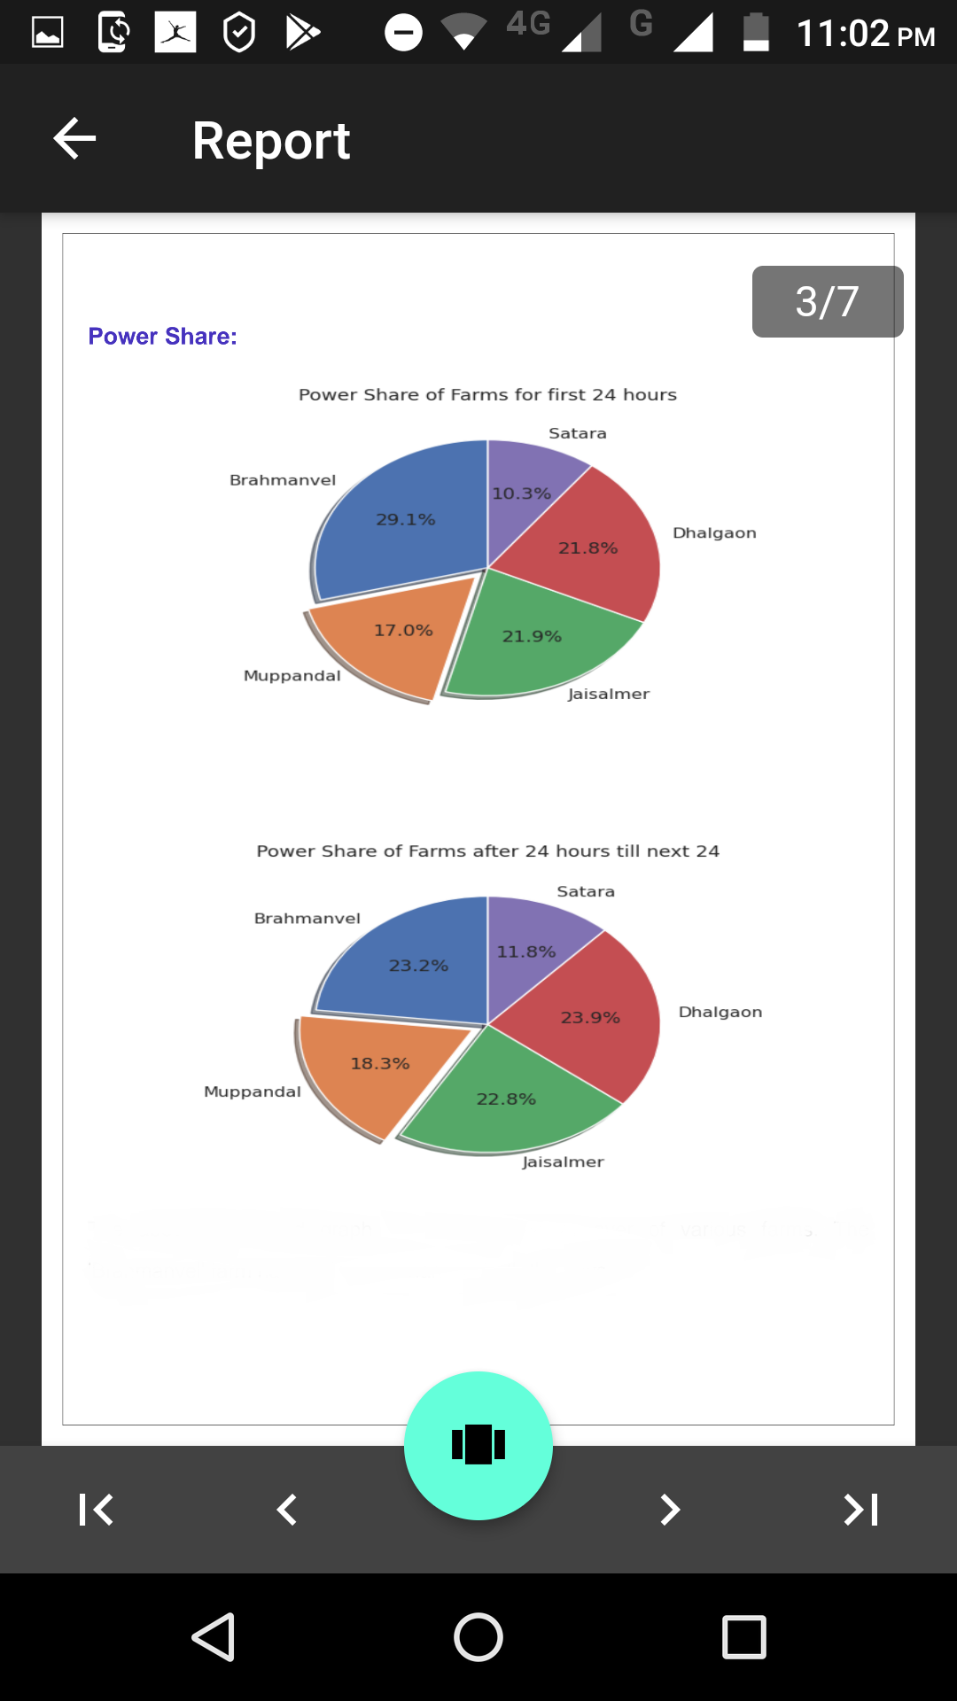
RESULTS OF QUERIES

Slide 9
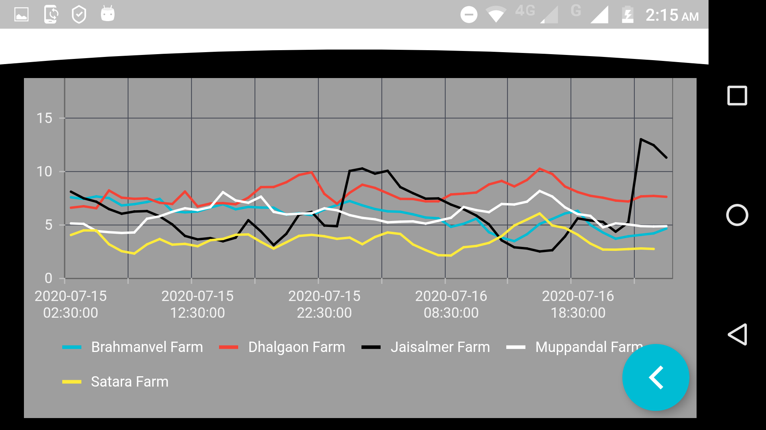
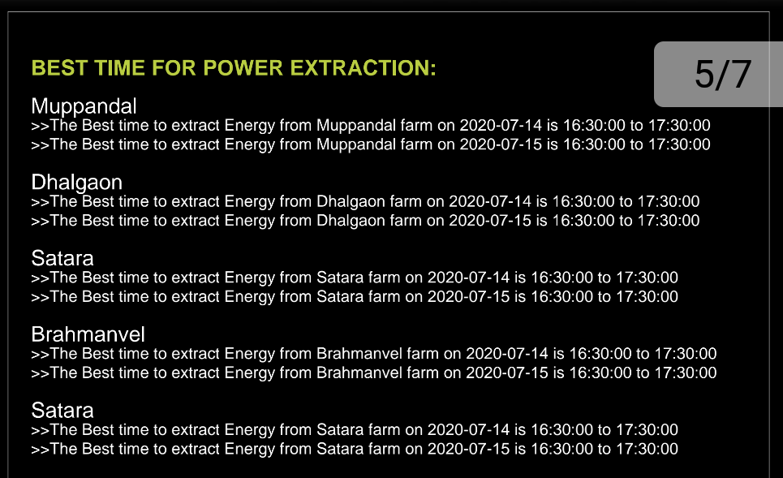
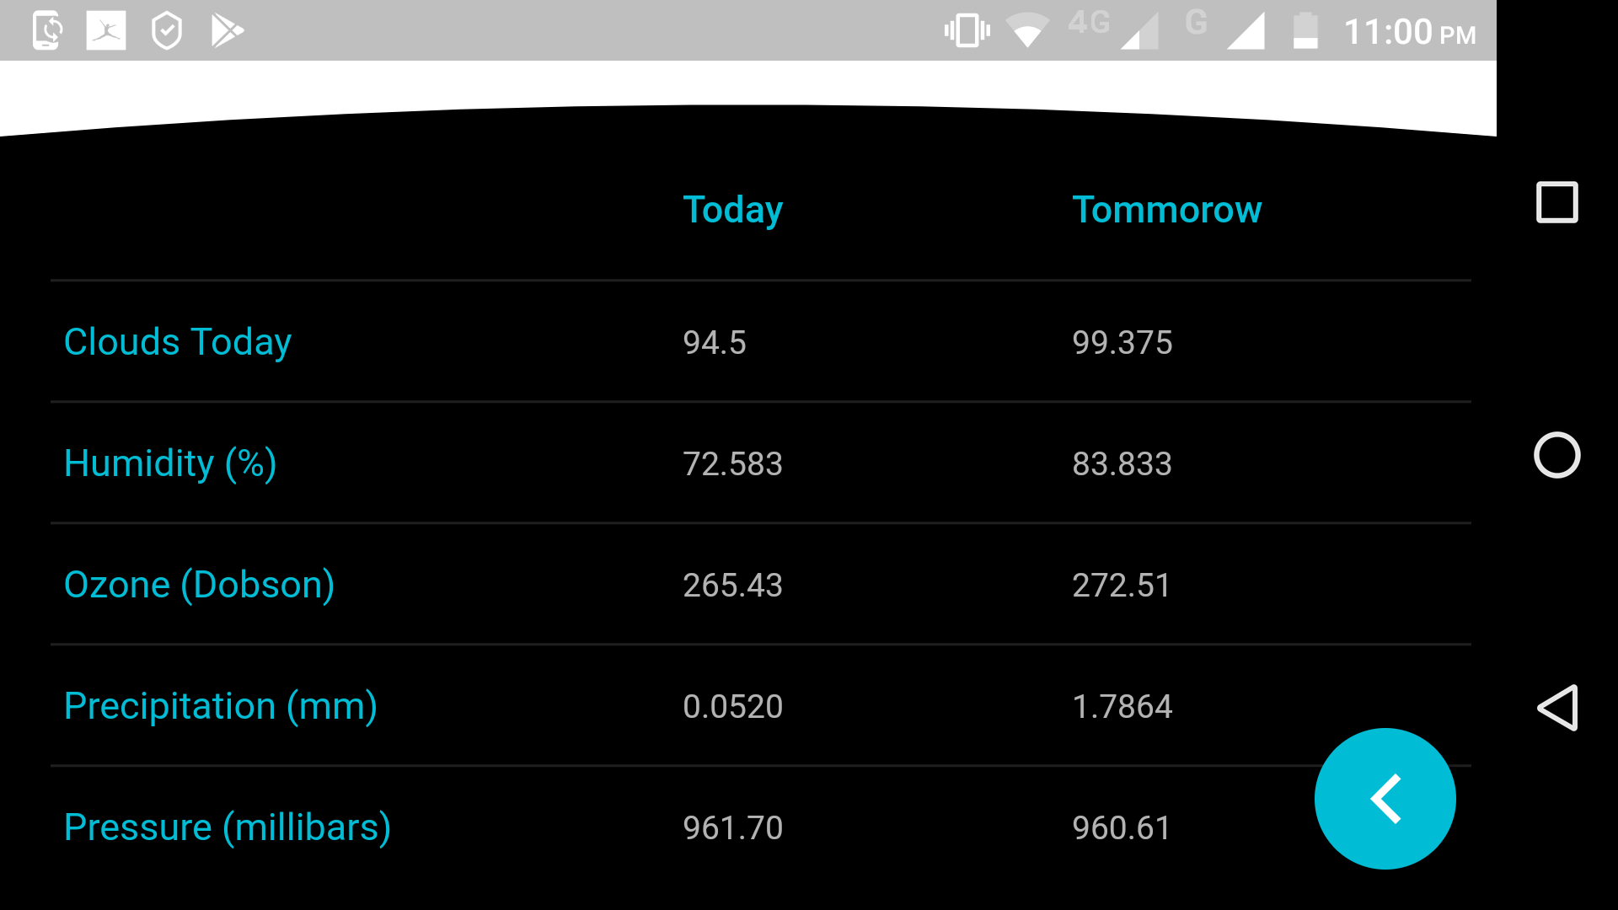
Optimal Output
Features Output

Slide 10
ADVANTAGES
From the output screens of the user interface it very easy to interpret the results without having any prior technical knowledge.
Thus, the output and observations can be used to effectively schedule the operation time of a turbine so as to generate maximum energy.
The application will not incur any kind of data loss in case of any kind of failure be it hardware or software relate. Because after every computation i.e. whenever new files are generated, the data is safely backed up.
The app is "driverless" i.e. it operates on its own and whenever the date changes, new data is fetched, new forecasts are generated, new reports and results are generated, all necessary files are backed up and the final output is sent to the application.

Slide 11
FUTURE SCOPE
For determining the best time to extract the energy from the wind farm, instead of using the naive approach used in this project, we can use more advanced algorithms like 'Maximum Sub-Array Problem' to determine the longest most productive time period for wind farm operation.
Addition of powerful models that can map non-linear data ver well can make the application more stable and reliable.
Due to computational and other resource related limitations some good performing models were dropped from the final ensemble. Thus, in large computational environment the existing approach can give better results.
More detailed analysis of the Energy supply and demand operation can be done if the daily electricity demand data is taken into account.

Slide 12
THANK YOU

